Slide 1






Fundamental Operating Systems
Lecture 07
CT4005NI - Computer Hardware and Software Architectures

Slide 2
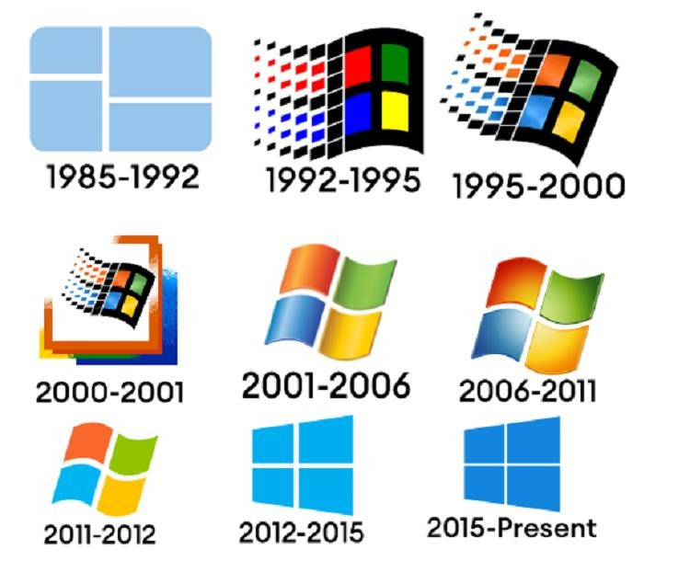
7. Introduction
The operating system (OS) controls almost all functions on a computer. You will learn about the components, functions, and terminology related to the OS.
Objectives
Explain the purpose of an operating system.
Describe and compare operating systems to include purpose, limitations, and compatibilities.
Determine the operating system based on customer needs.
Install an operating system.
Navigate a Graphical User Interface (GUI).
Identify and apply common preventive maintenance techniques for operating systems.
Troubleshoot operating systems

Slide 3
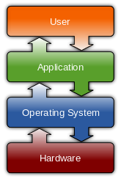
7.1 Explain the purpose of an OS
All computers rely on an OS to provide the interface for interaction between users, applications, and hardware.
Characteristics of modern OS
Control Hardware Access
The operating system manages the interaction between applications and the hardware
using a device driver for each hardware component.
A device driver is a small program written by the hardware manufacturer and supplied with the hardware component.
The process of assigning system resources and installing drivers can be performed with Plug and Play
(PnP).
The OS then configures the device and updates the registry, a database that contains all the information about the computer.

Slide 4
7.1 Explain the purpose of an OS
All computers rely on an OS to provide the interface for interaction between users, applications, and hardware.
Characteristics of modern OS
File and Folder Management
The operating system creates a file structure on the hard disk drive to allow data to be stored.
Examples: Files, Directories (Folders), Sub-Directories.
User Interface
Command Line Interface (CLI) – The user types commands at a prompt
Graphical User Interface (GUI) – The user interacts with menus and icons

Slide 5
7.1 Explain the purpose of an OS
All computers rely on an OS to provide the interface for interaction between users, applications, and hardware.
Characteristics of modern OS
Application Management
The operating system locates an application and loads it into the RAM of the computer
Example: word processors, databases, spreadsheets, games and so forth.
The operating system ensures that each application has adequate system resources.
An Application Programming Interface (API) is a set of guidelines used by programmers to ensure that the application they are developing is compatible with an operating system.
Open Graphics Library (OpenGL) – Cross-platform standard specification for multimedia graphics
DirectX – Collection of APIs related to multimedia tasks for Microsoft Windows

Slide 6
7.1 Explain the purpose of an OS
All computers rely on an OS to provide the interface for interaction between users, applications, and hardware.
7.1.2 Explain operating system concepts
Terms used to compare OS
Multi-User – Two or more users can work with programs and share peripheral devices, such as printers, at the same time.
Multi-Tasking – The computer is capable of operating multiple applications at the same time.
Multi-Processing – The computer can have two or more central processing units (CPUs) that programs share.
Multi-Threading – A program can be broken into smaller parts that can be loaded as needed by the operating system. Multi-threading allows individual programs to be multi- tasked.

Slide 7
7.1 Explain the purpose of an OS
All computers rely on an OS to provide the interface for interaction between users, applications, and hardware.
Explain operating system concepts
Operating Modes
The mode of operation determines how the CPU manages applications and memory.
All modern CPUs can run in different modes of operation.
Real Mode
A CPU can only execute 1 instruction at a time, and it can only address 1 MB of system memory.
used by DOS and DOS applications. Such as Windows 3.x

Slide 8
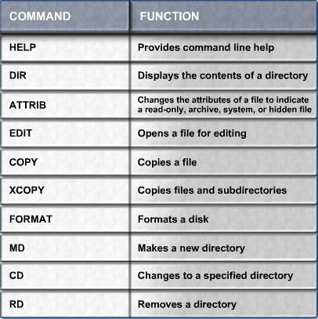
7.1 Explain the purpose of an OS
Real Mode – MSDOS popular commands

Slide 9
7.1 Explain the purpose of an OS
All computers rely on an OS to provide the interface for interaction between users, applications, and
hardware.
Explain operating system concepts
Operating Modes
Protected Mode
A CPU that operates in protected mode has access to all of the memory in the computer, including
virtual memory.
Virtual memory is hard disk space that is used to emulate RAM.
can execute multiple instructions simultaneously.
used by 32/64-bit operating systems, such as Windows 2000 or Windows XP, Window 7 and Windows
10
In protected mode, application are protected from using the memory reserved for another application that is currently running.

Slide 10
7.1 Explain the purpose of an OS
Virtual Real Mode
A CPU that operates in virtual real mode allows a real-mode application to run within a protected-mode
operating system.
Example: Dos running in windows XP
Compatibility Mode
Compatibility mode creates the environment of an earlier operating system for applications that are not compatible with the current operating system.
Example: running a setup file of any software in windows 10 with the compatibility mode of windows 7

Slide 11
7.1 Explain the purpose of an OS
All computers rely on an OS to provide the interface for interaction between users, applications, and
hardware.
7.1.2 Explain operating system concepts
Processor Architecture
Two common architectures used to process data: x86 (32-bit architecture) and x64 (64-bit architecture).
Registers are storage areas used by the CPU when performing calculations.
The additional registers of the x64 architecture allow the computer to process much more complex
instructions at a much higher rate.

Slide 12
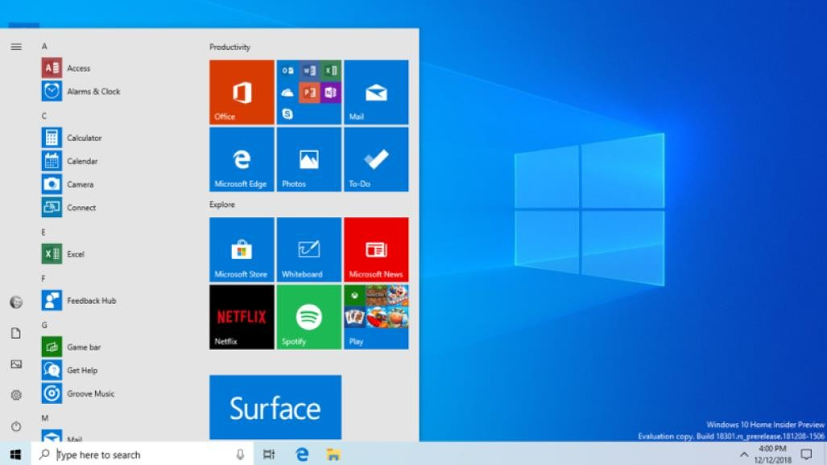
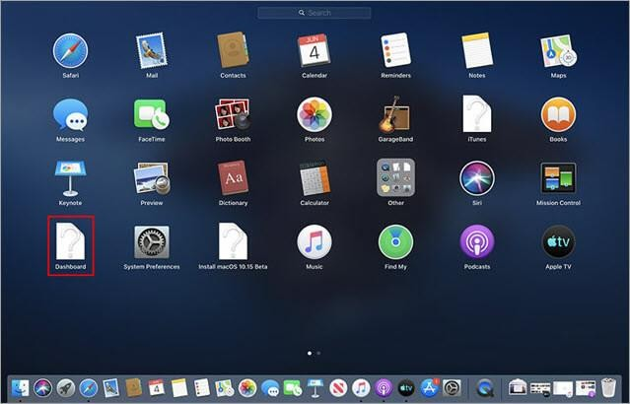
7.2 Describe and compare operating systems
There
are two
distinct types of
operating
systems: desktop operating
systems and network operating systems.
Desktop OS - Small Office/Home Office (SOHO)
Supports a single user
Runs single-user applications
Shares files and folders on a small network with limited security

Slide 13
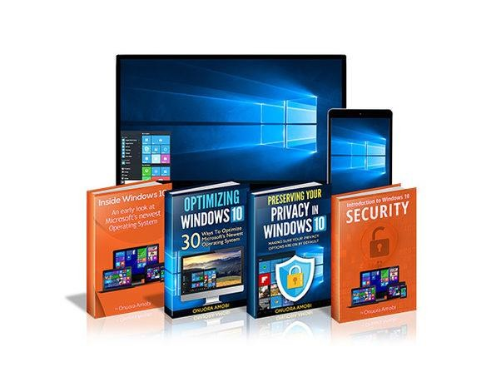
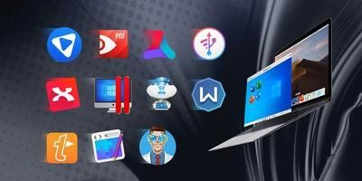
7.2 Describe and compare operating systems
Microsoft Windows
one of the most popular operating systems today.
Example: Windows 10, Window 7 , Windows Vista Home Basic, Business, Ultimate and
so forth.
Apple Mac OS
Apple computers are proprietary and use an operating system called Mac OS.
Current versions of Mac OS are now based on a customized version of UNIX.

Slide 14
7.2 Describe and compare operating systems
Desktop OS - Small Office/Home Office (SOHO)
UNIX/Linux
UNIX, which was introduced in the late 1960s, is one of the oldest operating systems.
There are many different versions of UNIX, example Linux.
Linux was developed by Linus Torvalds in 1991, and it is designed as an open-source operating system.
Open-source programs allow the source code to be distributed and changed by anyone as a free download or from developers at a much lower cost than other operating systems.

Slide 15
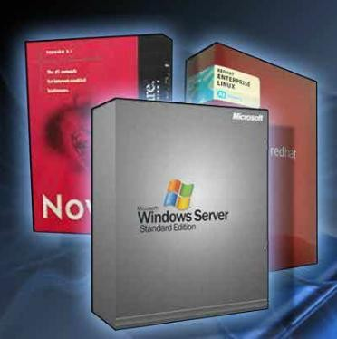
7.2 Describe and compare operating systems
Network OS - corporate environment
Supports multiple users
Runs multi-user applications
Is robust
Provides increased security compared to desktop operating systems
Examples:
Microsoft Windows: Windows Server 2003, and Windows Server 2008 and Server 2012.
Linux: Red Hat, Fedora, CentOS and so forth.

Slide 16
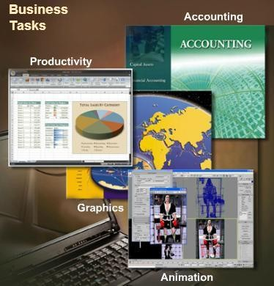
7.3 Determine operating system based on customer needs
7.3.1 Identify applications and environments
An operating system should be
installed on a computer.
compatible
with
all applications that are
Before recommending an OS to your customer, investigate the types of applications that your customer will be using.
Does the computer have “off-the-shelf” applications or customized applications that
were programmed specifically for this customer?
Are the applications programmed for a single user or multiple users?
Are any data files shared with other computers, such as a laptop or home computer?
To ensure compatibility

Slide 17
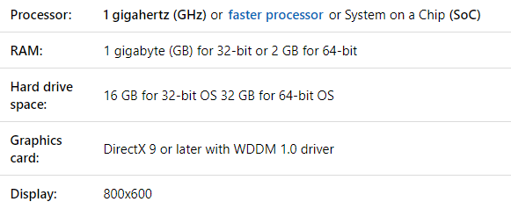
7.3 Determine operating system based on customer needs
7.3.2 Determine minimum hardware requirements
Operating systems have minimum hardware requirements that must be met for the OS to install and function correctly.
Hardware Compatibility List
Most operating systems have a Hardware Compatibility List (HCL) that can be found on the manufacturer's website.

Slide 18
7.4 Install an operating system
As a technician, you might have to perform a clean installation of an operating system.
When, a computer is passed from one employee to another
When, the operating system is corrupted
When, a new replacement hard drive is installed in a computer
7.4.1 Identify hard drive setup procedures
Although it is possible to install an operating system over a network from a server or from a local hard drive, the most common installation method is with CDs and DVDs.

Slide 19
7.4 Install an operating system
7.4.1 Identify hard drive setup procedures
Partitioning and Formatting
Before installing an operating system on a hard drive, the hard drive must be partitioned and formatted.
During the installation phase, most operating systems automatically partition and format the hard drive.
Primary partition – This partition is usually the first partition. Cannot be subdivided into smaller sections.
There can be up to four partitions per hard drive.
Active partition – This partition is the partition used by the operating system to boot the computer.
Only primary partition can be marked active.
Extended partition – This partition normally uses the remaining free space on a hard drive.
It can be subdivided into smaller sections called logical drives.

Slide 20
7.4 Install an operating system Contd.
Logical drive – This drive is a section of an extended partition that can be used to separate information for administrative purposes.
An extended partition can contain up to 24 logical partitions.
Formatting – This process prepares a file system in a partition for files to be stored.
Sector – A sector contains a fixed number of bytes, generally at least 512 bytes.
Cluster – file allocation unit.
It is the smallest unit of space used for storing data, made up of one or more sectors.
Track – A track is one complete circle of data on one side of a hard drive platter.
A track is broken into groups of sectors.

Slide 21
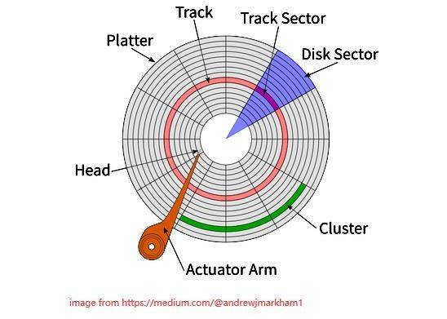
7.4 Install an operating system Contd.
Drive mapping – Drive mapping is a letter assigned to a physical or logical drive.

Slide 22
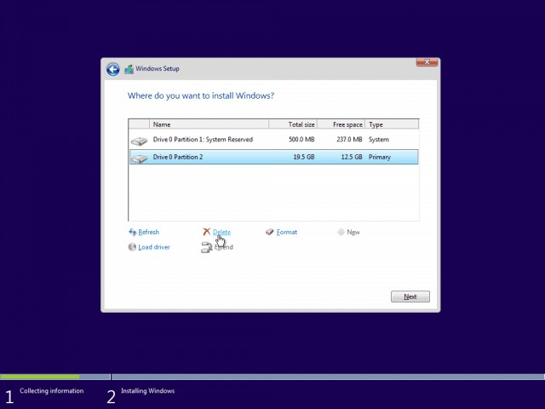
7.4 Install an operating system Contd.
7.4.2 Prepare hard drive
The file system provides the directory structure that organizes
the user's operating system, application, configuration, and data files.
This process prepares the disk to accept the file system.
File Allocation Table, 32-bit (FAT32) – A file system that can support partition sizes up to 2 TB or 2,048 GB.
New Technology File System (NTFS) – A file system that can support partition sizes up to 16 Exabytes, in theory.
It incorporates more file system security features and extended attributes.

Slide 23
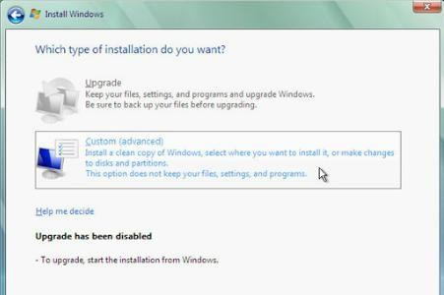
7.4 Install an operating system Contd.
7.4.3 Install the operating system
There might be three options that you may encounter during OS installation.
Upgrade
Keep your files, settings, and programs and upgrade Windows. Also use this option to repair an installation.
Custom (advanced)
Install a clean copy of Windows, select where you want to install it, or make changes to disks and partitions.
Quit – To quit Setup, click the x in the Close box.
Further, during the installation process you also have to install certain information like Product Key, Date and Time and so forth.

Slide 24
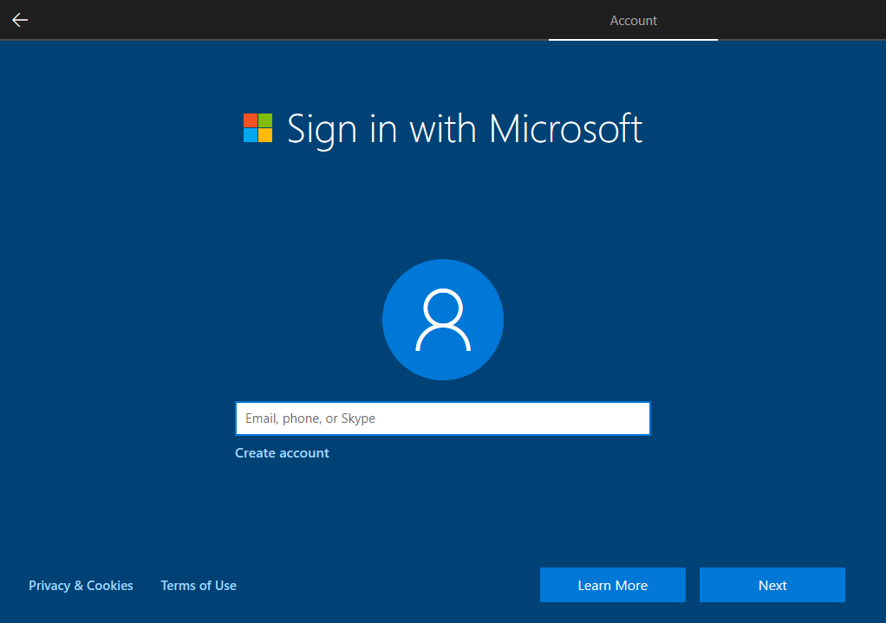
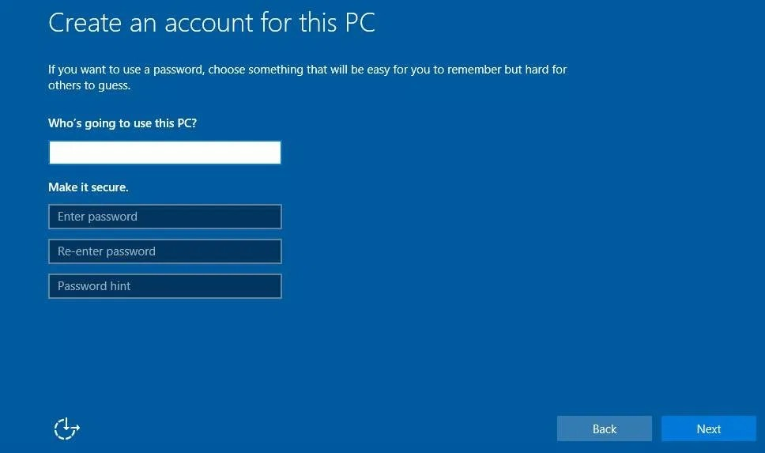
7.4 Install an operating system Contd.
7.4.4 Create accounts
Create a user prompted
account when
during the installation
process. Unlike the administrator account, user accounts can be created at any time.
A user account has fewer permissions than the computer administrator.

Slide 25
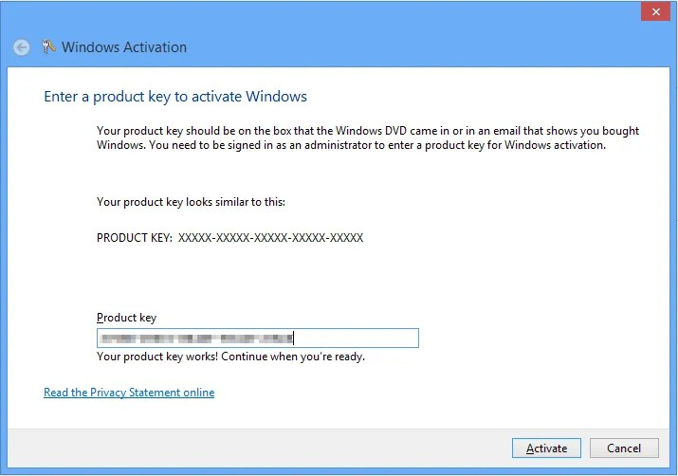
7.4 Install an operating system Contd.
7.4.6 Complete the installation
You must register your OS and complete the verification that ensures that you are using a legal copy of the OS.
Doing so enables you to download patches and service packs.
Install all service packs and all patches from Windows Update.
Verify that all hardware is installed correctly in Device Manager.

Slide 26
7.4 Install an operating system Contd.
7.4.6 Custom Installation Options
Installing OS in one computer takes time, imagine to install OS in corporate environment that contains large
number of computers.
There are number of ways so that technicians are able to quickly install an operating system.
Disk Cloning - Disk cloning creates an image of a hard drive in a computer.
Network Installation - Installing windows over a network.
Recovery Disc - You can use a recovery disc when there has been a system failure and other recovery options have failed.
Factory Recovery Partition - Some computers that have OS from factory contain a section of disk that contains an image of the bootable partition.

Slide 27
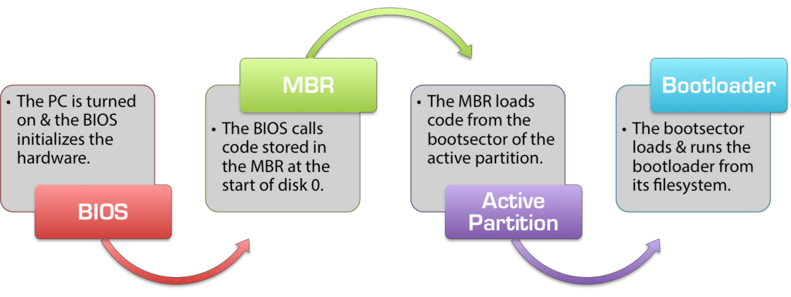
7.4 Install an operating system Contd.
7.4.7 Identify the boot sequence files and Registry files

Slide 28
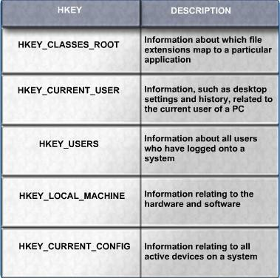
7.4 Install an operating system Contd.
7.4.7 Identify the boot sequence files and Registry files

Slide 29
7.4 Install an operating system Contd.
7.4.8 Describe how to manipulate operating system files
The following applications are used extensively for post-installation diagnostics and modifications:
Msconfig – This boot configuration utility allows you to set the programs that run at startup and to edit
configuration files.
Regedit – This application allows you to edit the registry
Msinfo32 – This utility displays a complete system summary of your computer including hardware
components and details, and installed software and settings.
Dxdiag – This utility shows details about all of the DirectX components and drivers that are installed in your computer.
Cmd – This is used to execute command line programs and utilities

Slide 30
7.4 Install an operating system Contd.
Startup Modes
You can boot Windows in one of many different modes by pressing the F8 key during the boot process.
Safe Mode – Starts Windows but only loads drivers for basic components, such as the keyboard and display.
Safe Mode with Networking Support – Starts Windows identically to Safe Mode and also loads the drivers for network components.
Safe Mode with Command Prompt – Starts Windows and loads the command prompt instead of the GUI.
Last Known Good Configuration – Enables a user to load the configuration settings of Windows that
were used the last time that Windows started successfully .

Slide 31
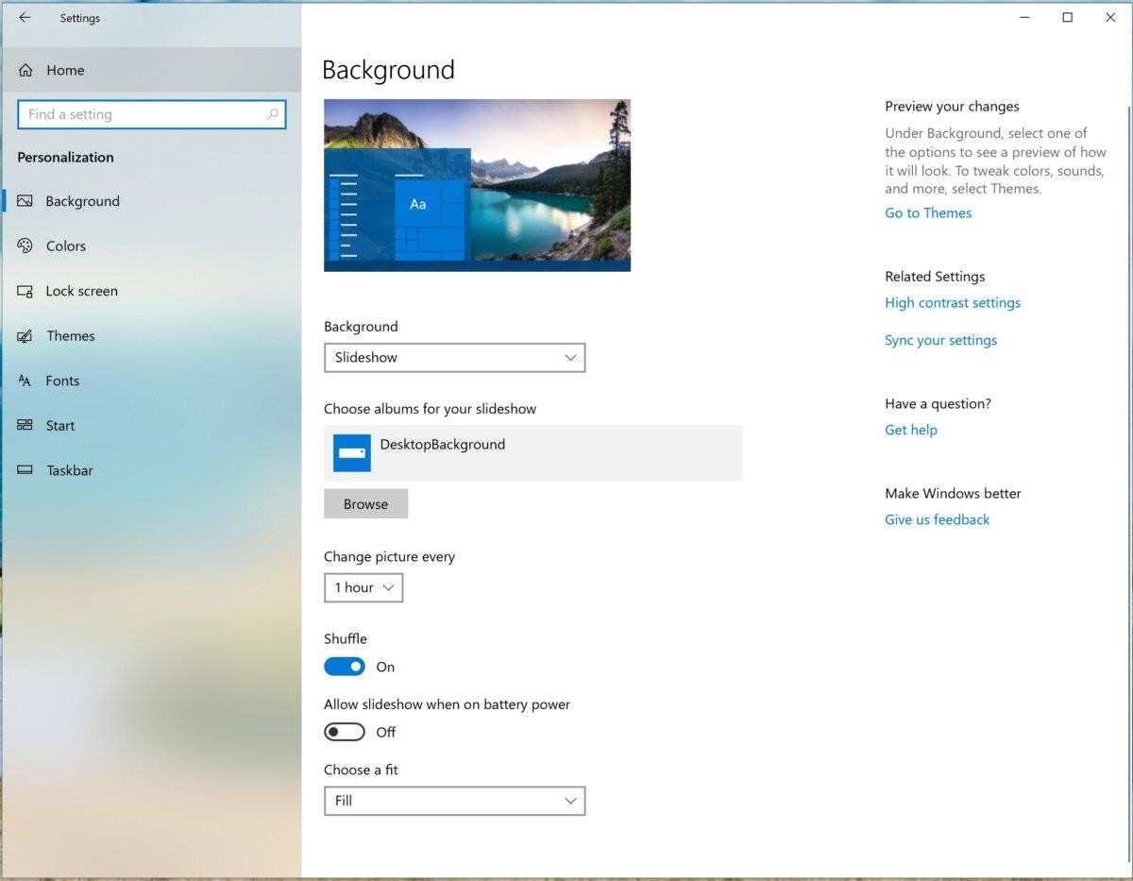
7.6 Navigate a GUI (Windows)
7.7.1 Manipulate items on the desktop
After the operating system has been installed, the desktop can be
customized to suit individual needs.
A desktop on a computer is a graphical representation of a workspace.
The desktop has icons, toolbars, and menus to manipulate files.
Examples: Desktop Properties, Desktop Item, My Computer, My Network Places and so forth.

Slide 32
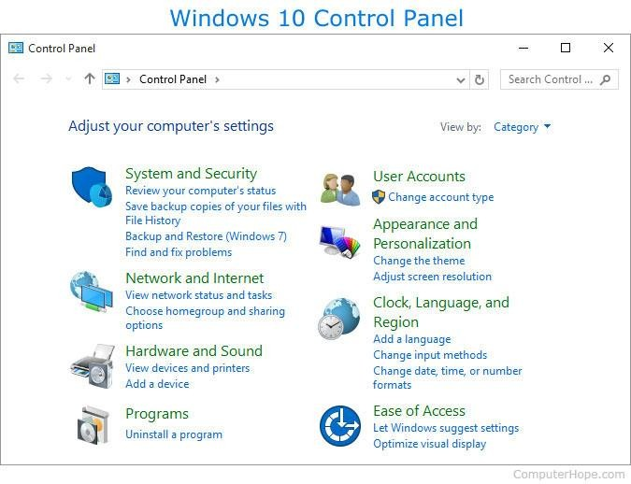
7.6 Navigate a GUI (Windows)
7.7.2 Control Panel applets
The names of various applets in the Control Panel differ slightly depending on the version of Windows installed.
Examples: Appearance and Themes, Network and Internet Connections, Add or Remove Programs, Sounds, Speech, and Audio Devices, and so forth.

Slide 33
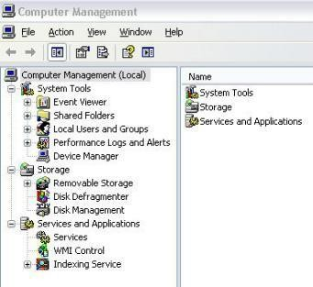
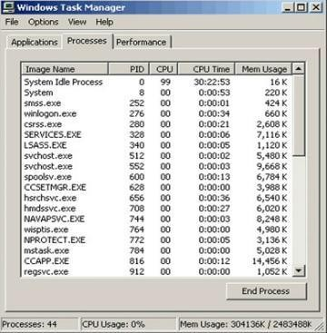
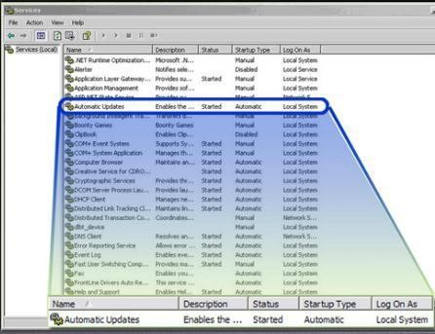
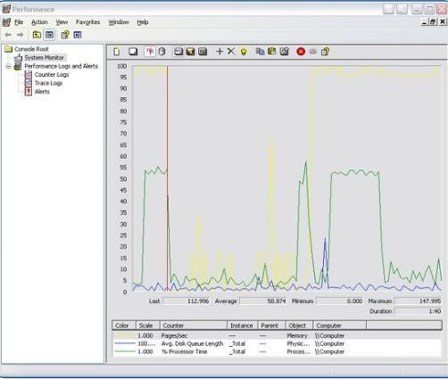
7.6 Navigate a GUI (Windows)
Administrative Tools
Computer Management
Device Manager
Task Manager
Services
Performance Monitor
Event Viewer
Microsoft Management console (MMC)
Remote Desktop
Performance Settings

Slide 34
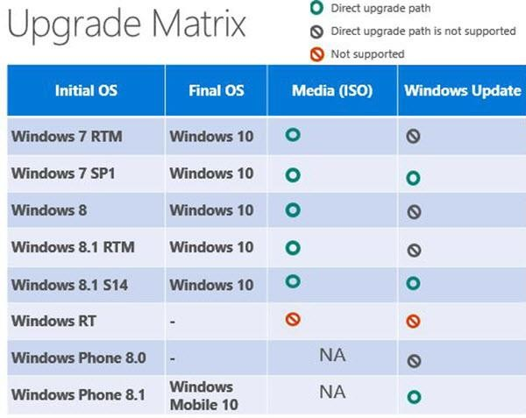
7.6 Navigate a GUI (Windows)
7.7.4 Upgrading an Operating System

Slide 35
End of Lecture 7

